Slide 1
High-Dimensional Continuous Control Using Generalized Advantage Estimation
Presented by Jialun Lyu and Zhibo Zhang
Original Paper: Schulman, John & Moritz, Philipp & Levine, Sergey & Jordan, Michael & Abbeel, Pieter. (2015).
High-Dimensional Continuous Control Using Generalized Advantage Estimation.

Slide 2
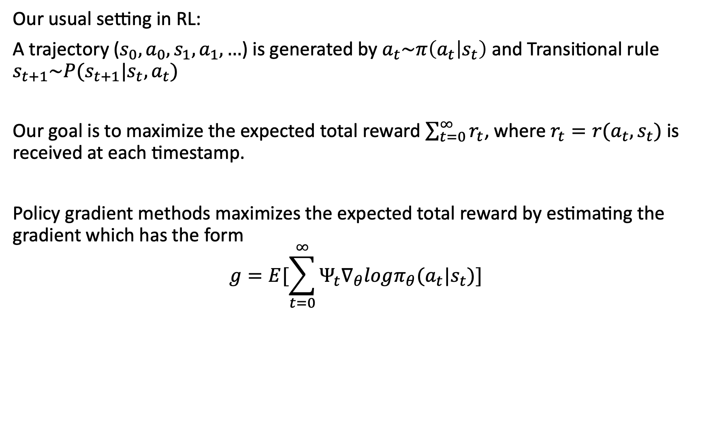
Problem Setting
Our usual setting in RL:
A trajectory ($s_{0}, a_{0}, s_{1}, a_{1}, …$) is generated by $a_{t}\sim π\left(a_{t} | s_{t}\right)$ and Transitional rule $s_{t+1}\sim P(s_{t+1}|s_{t},a_{t})$
Our goal is to maximize the expected total reward $\sum_{t=0}^{∞}{r_{t}}$, where $r_{t}=r(a_{t},s_{t})$ is received at each timestamp.
Policy gradient methods maximizes the expected total reward by estimating the gradient which has the form
$$g=E[\sum_{t=0}^{∞}{Ψ_{t}∇_{θ}logπ_{θ}(a_{t}|s_{t})}]$$

Slide 3
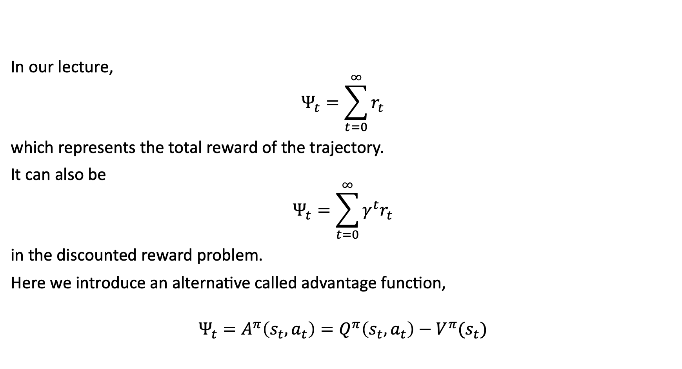
Policy Gradient
In our lecture,
$$Ψ_{t}=\sum_{t=0}^{∞}{r_{t}}$$
which represents the total reward of the trajectory.
It can also be
$$Ψ_{t}=\sum_{t=0}^{∞}{γ^{t}r_{t}}$$
in the discounted reward problem.
Here we introduce an alternative called advantage function,
$$Ψ_{t}=A^{π}\left(s_{t},a_{t}\right)=Q^{π}\left(s_{t},a_{t}\right)−V^{π}(s_{t})$$

Slide 4
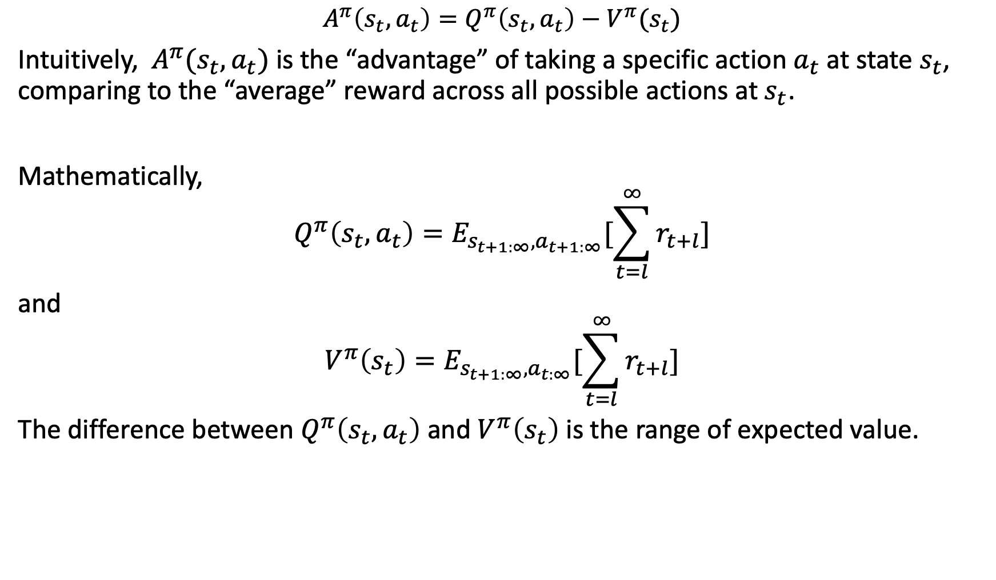
Advantage Function
$$A^{π}\left(s_{t},a_{t}\right)=Q^{π}\left(s_{t},a_{t}\right)−V^{π}(s_{t})$$
Intuitively, $A^{π}(s_{t},a_{t})$ is the “advantage” of taking a specific action $a_{t}$ at state $s_{t}$, comparing to the “average” reward across all possible actions at $s_{t}$.
Mathematically,
$$Q^{π}\left(s_{t},a_{t}\right)=E_{s_{t+1:∞}, a_{t+1:∞}}[\sum_{t=l}^{∞}{r_{t+l}}]$$
and
$$V^{π}\left(s_{t}\right)=E_{s_{t+1:∞}, a_{t:∞}}[\sum_{t=l}^{∞}{r_{t+l}}]$$
The difference between $Q^{π}\left(s_{t},a_{t}\right)$ and $V^{π}\left(s_{t}\right)$ is the range of expected value.

Slide 5
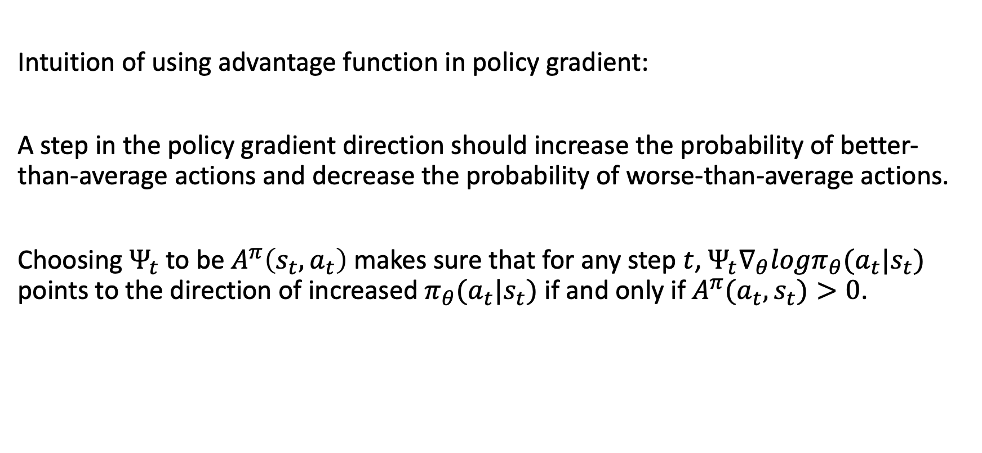
Advantage Function
Intuition of using advantage function in policy gradient:
A step in the policy gradient direction should increase the probability of better-than-average actions and decrease the probability of worse-than-average actions.
Choosing $Ψ_{t}$ to be $A^{π}\left(s_{t},a_{t}\right)$ makes sure that for any step $t$, $Ψ_{t}∇_{θ}logπ_{θ}(a_{t}|s_{t})$ points to the direction of increased $π_{θ}(a_{t}|s_{t})$ if and only if $A^{π}(a_{t},s_{t})>0$.

Slide 6
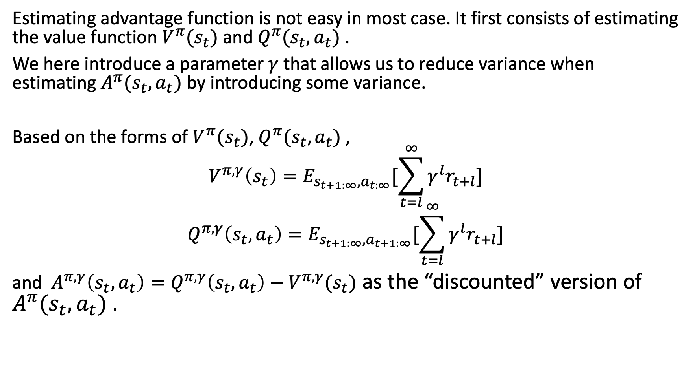
Estimating Advantage Function
Estimating advantage function is not easy in most case. It first consists of estimating the value function $V^{π}(s_{t})$ and $Q^{π}(s_{t},a_{t})$ .
We here introduce a parameter $γ$ that allows us to reduce variance when estimating $A^{π}(s_{t},a_{t})$ by introducing some variance.
Based on the forms of $V^{π}(s_{t})$, $Q^{π}(s_{t},a_{t})$ ,
$$V^{π, γ}\left(s_{t}\right)=E_{s_{t+1:∞}, a_{t:∞}}[\sum_{t=l}^{∞}{γ^{l}r_{t+l}}]$$
$$Q^{π,γ}\left(s_{t},a_{t}\right)=E_{s_{t+1:∞}, a_{t+1:∞}}[\sum_{t=l}^{∞}{γ^{l}r_{t+l}}]$$
and $A^{π,γ}\left(s_{t},a_{t}\right)=Q^{π,γ}\left(s_{t},a_{t}\right)−V^{π,γ}(s_{t})$ as the “discounted” version of $A^{π}(s_{t},a_{t})$ .

Slide 7
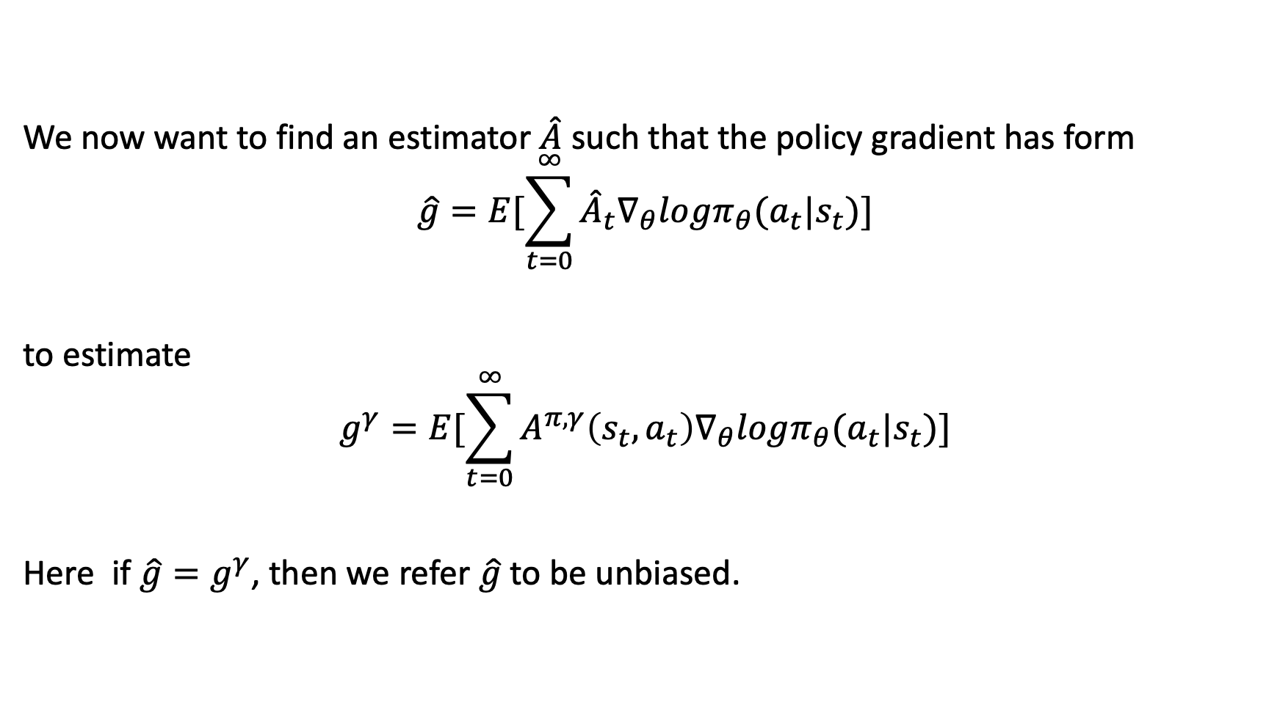
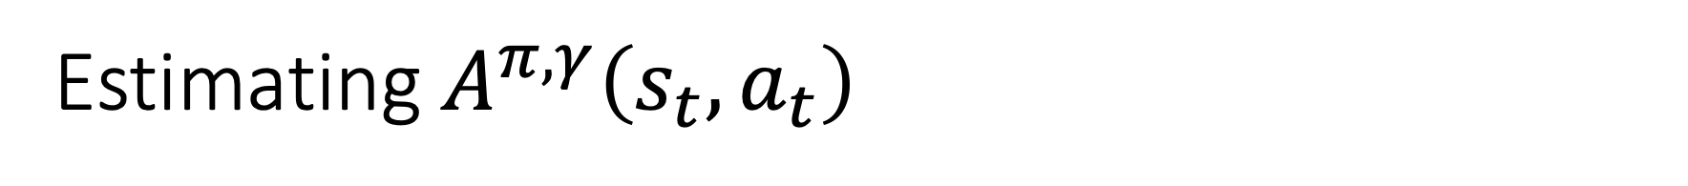
Estimating $A^{π,γ}\left(s_{t},a_{t}\right)$
We now want to find an estimator $\hat{A}$ such that the policy gradient has form
$$\hat{g}=E[\sum_{t=0}^{∞}{{\hat{A}}_{t}∇_{θ}logπ_{θ}(a_{t}|s_{t})}]$$
to estimate
$$g^{γ}=E[\sum_{t=0}^{∞}{A^{π,γ}\left(s_{t},a_{t}\right)∇_{θ}logπ_{θ}(a_{t}|s_{t})}]$$
Here if $\hat{g}=g^{γ}$, then we refer $\hat{g}$ to be unbiased.

Slide 8
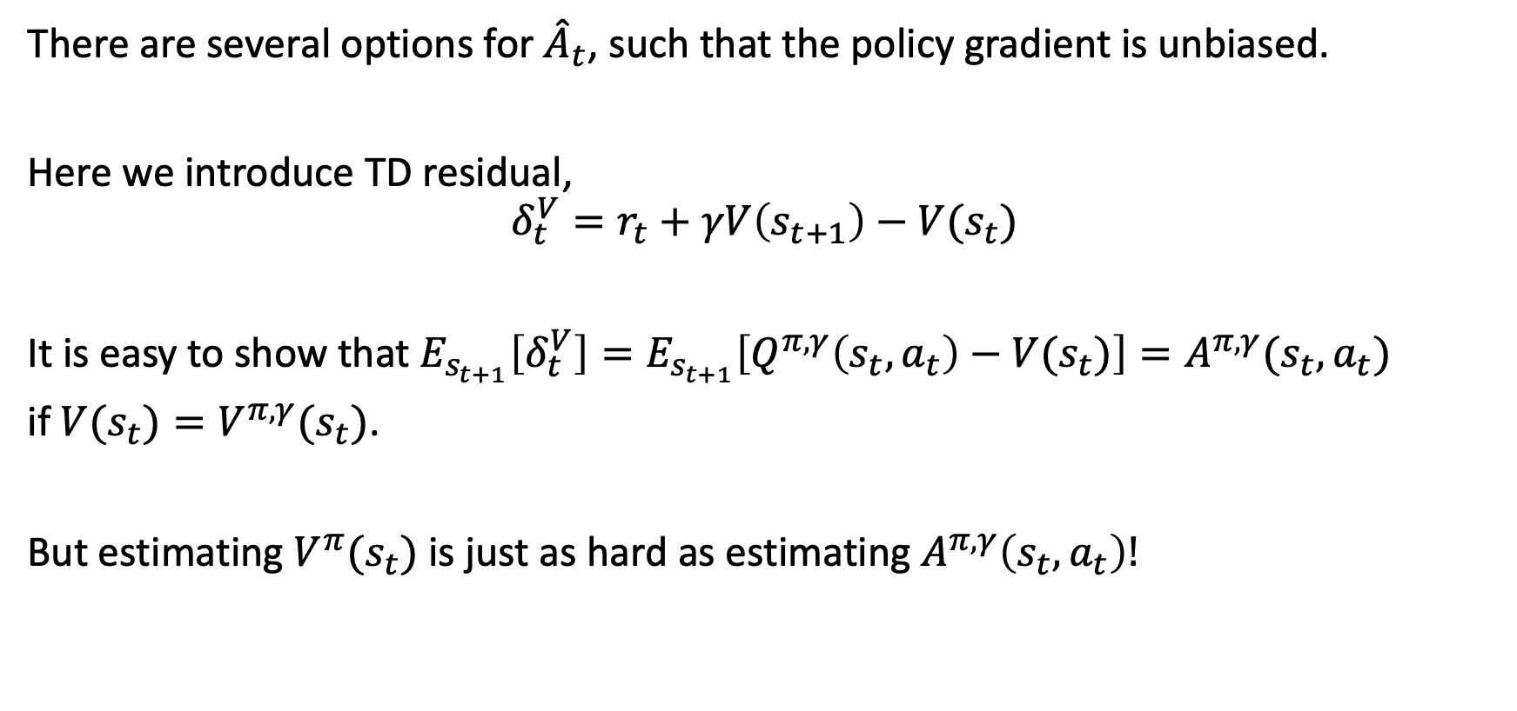

Finding ${\hat{A}}_{t}$
There are several options for ${\hat{A}}_{t}$, such that the policy gradient is unbiased.
Here we introduce TD residual,
$$δ_{t}^{V}=r_{t}+γV\left(s_{t+1}\right)−V(s_{t})$$
It is easy to show that $E_{s_{t+1}}\left[δ_{t}^{V}\right]=E_{s_{t+1}}\left[Q^{π,γ}\left(s_{t},a_{t}\right)−V(s_{t})\right]=A^{π,γ}(s_{t},a_{t})$
if $V(s_{t})=V^{π,γ}(s_{t})$.
But estimating $V^{π}(s_{t})$ is just as hard as estimating $A^{π,γ}\left(s_{t},a_{t}\right)!$

Slide 9
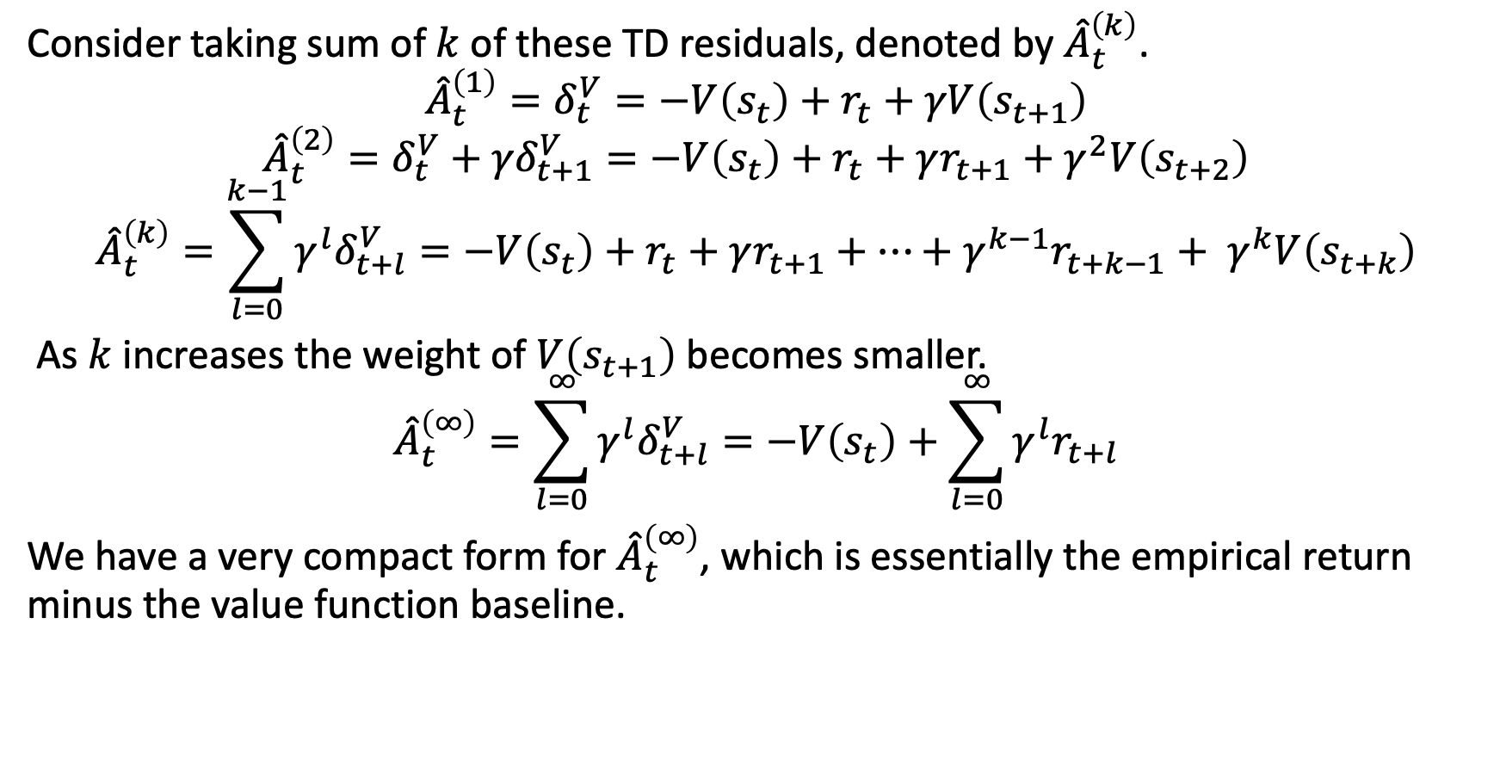
Finding ${\hat{A}}_{t}$
Consider taking sum of $k$ of these TD residuals, denoted by ${\hat{A}}_{t}^{\left(k\right)}$.
$${\hat{A}}_{t}^{\left(1\right)}=δ_{t}^{V}=−V\left(s_{t}\right)+r_{t}+γV\left(s_{t+1}\right)$$
$${\hat{A}}_{t}^{\left(2\right)}=δ_{t}^{V}+{γδ}_{t+1}^{V}=−V\left(s_{t}\right)+r_{t}+γr_{t+1}+γ^{2}V\left(s_{t+2}\right)$$
$${\hat{A}}_{t}^{\left(k\right)}=\sum_{l=0}^{k−1}{{γ^{l}δ}_{t+l}^{V}}=−V\left(s_{t}\right)+r_{t}+γr_{t+1}+…+γ^{k−1}r_{t+k−1}+ γ^{k}V\left(s_{t+k}\right)$$
As $k$ increases the weight of $V\left(s_{t+1}\right)$ becomes smaller.
$${\hat{A}}_{t}^{\left(∞\right)}=\sum_{l=0}^{∞}{{γ^{l}δ}_{t+l}^{V}}=−V\left(s_{t}\right)+\sum_{l=0}^{∞}{γ^{l}r_{t+l}}$$
We have a very compact form for ${\hat{A}}_{t}^{\left(∞\right)}$, which is essentially the empirical return minus the value function baseline.

Slide 10
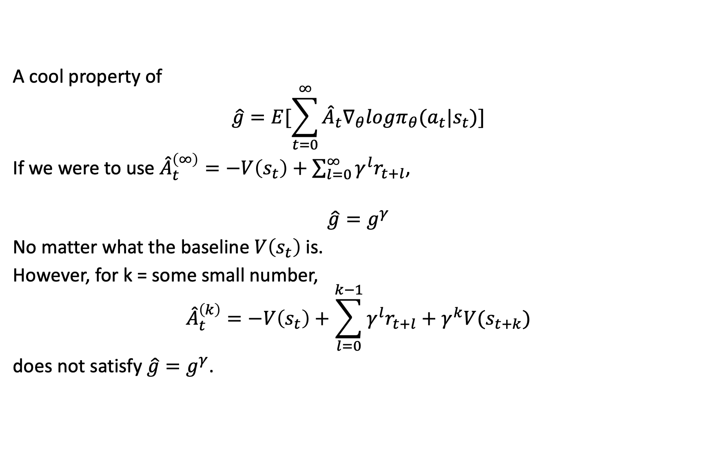
Finding ${\hat{A}}_{t}$
A cool property of
$$\hat{g}=E[\sum_{t=0}^{∞}{{\hat{A}}_{t}∇_{θ}logπ_{θ}(a_{t}|s_{t})}]$$
If we were to use ${\hat{A}}_{t}^{\left(∞\right)}=−V\left(s_{t}\right)+\sum_{l=0}^{∞}{γ^{l}r_{t+l}}$,
$$\hat{g}=g^{γ}$$
No matter what the baseline $V\left(s_{t}\right)$ is.
However, for k = some small number,
$${\hat{A}}_{t}^{\left(k\right)}=−V\left(s_{t}\right)+\sum_{l=0}^{k−1}{γ^{l}r_{t+l}}+γ^{k}V(s_{t+k})$$
does not satisfy $\hat{g}=g^{γ}$.

Slide 11
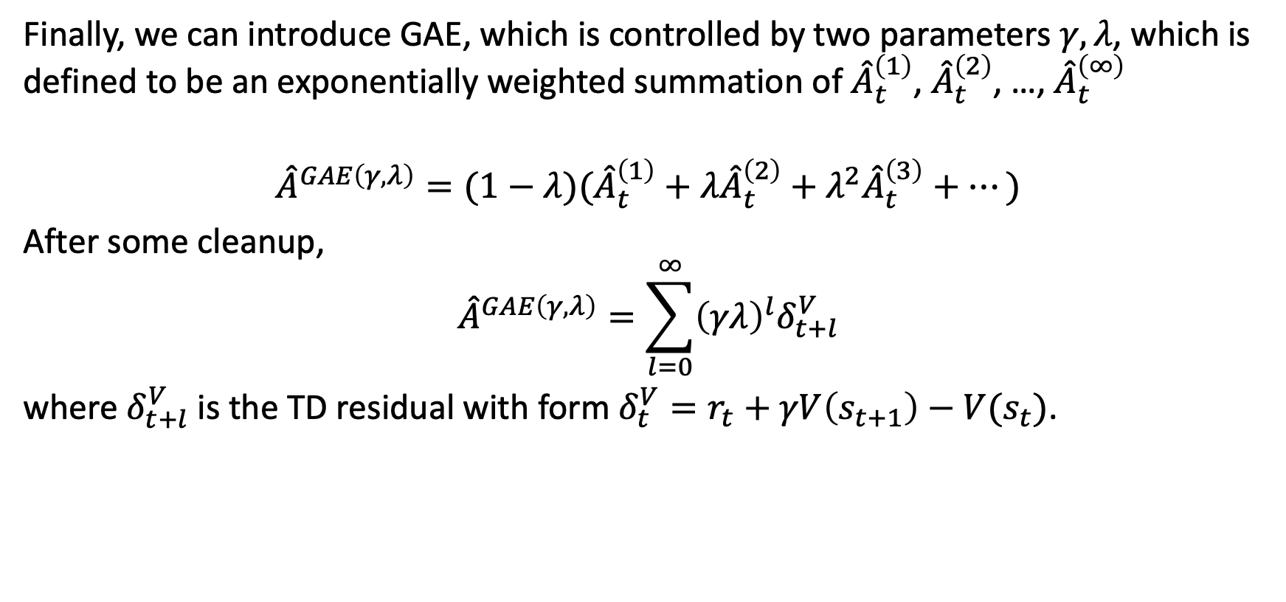
General Advantage Estimation (GAE)
Finally, we can introduce GAE, which is controlled by two parameters $γ, λ$, which is defined to be an exponentially weighted summation of ${\hat{A}}_{t}^{\left(1\right)}$, ${\hat{A}}_{t}^{\left(2\right)}$, …, ${\hat{A}}_{t}^{\left(∞\right)}$
$${\hat{A}}^{GAE\left(γ,λ\right)}=(1−λ)({\hat{A}}_{t}^{\left(1\right)}+λ{\hat{A}}_{t}^{\left(2\right)}+λ^{2}{\hat{A}}_{t}^{\left(3\right)}+…)$$
After some cleanup,
$${\hat{A}}^{GAE\left(γ,λ\right)}=\sum_{l=0}^{∞}{{\left(γλ\right)}^{l}δ_{t+l}^{V}}$$
where $δ_{t+l}^{V}$ is the TD residual with form $δ_{t}^{V}=r_{t}+γV\left(s_{t+1}\right)−V(s_{t})$.

Slide 12
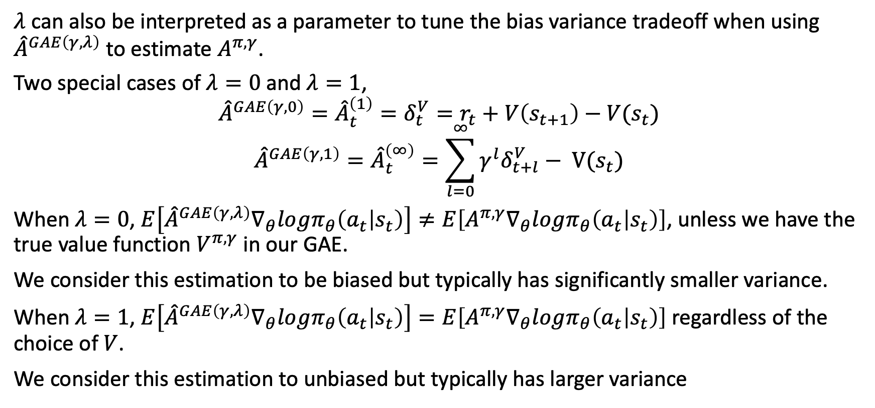

Interpretation of Parameter $λ$
$λ$ can also be interpreted as a parameter to tune the bias variance tradeoff when using ${\hat{A}}^{GAE\left(γ,λ\right)}$ to estimate $A^{π,γ}$.
Two special cases of $λ=0$ and $λ=1$,
$${\hat{A}}^{GAE\left(γ,0\right)}={\hat{A}}_{t}^{\left(1\right)}=δ_{t}^{V}=r_{t}+V\left(s_{t+1}\right)−V(s_{t})$$
$${\hat{A}}^{GAE\left(γ,1\right)}={\hat{A}}_{t}^{\left(∞\right)}=\sum_{l=0}^{∞}{{γ^{l}δ}_{t+l}^{V}}− V(s_{t})$$
When $λ=0$, $E\left[{\hat{A}}^{GAE\left(γ,λ\right)}∇_{θ}logπ_{θ}\left(a_{t} | s_{t}\right)\right]≠E\left[A^{π,γ}∇_{θ}logπ_{θ}\left(a_{t} | s_{t}\right)\right]$, unless we have the true value function $V^{π,γ}$ in our GAE.
We consider this estimation to be biased but typically has significantly smaller variance.
When $λ=1$, $E\left[{\hat{A}}^{GAE\left(γ,λ\right)}∇_{θ}logπ_{θ}\left(a_{t} | s_{t}\right)\right]=E\left[A^{π,γ}∇_{θ}logπ_{θ}\left(a_{t} | s_{t}\right)\right]$ regardless of the choice of $V$.
We consider this estimation to unbiased but typically has larger variance

Slide 13
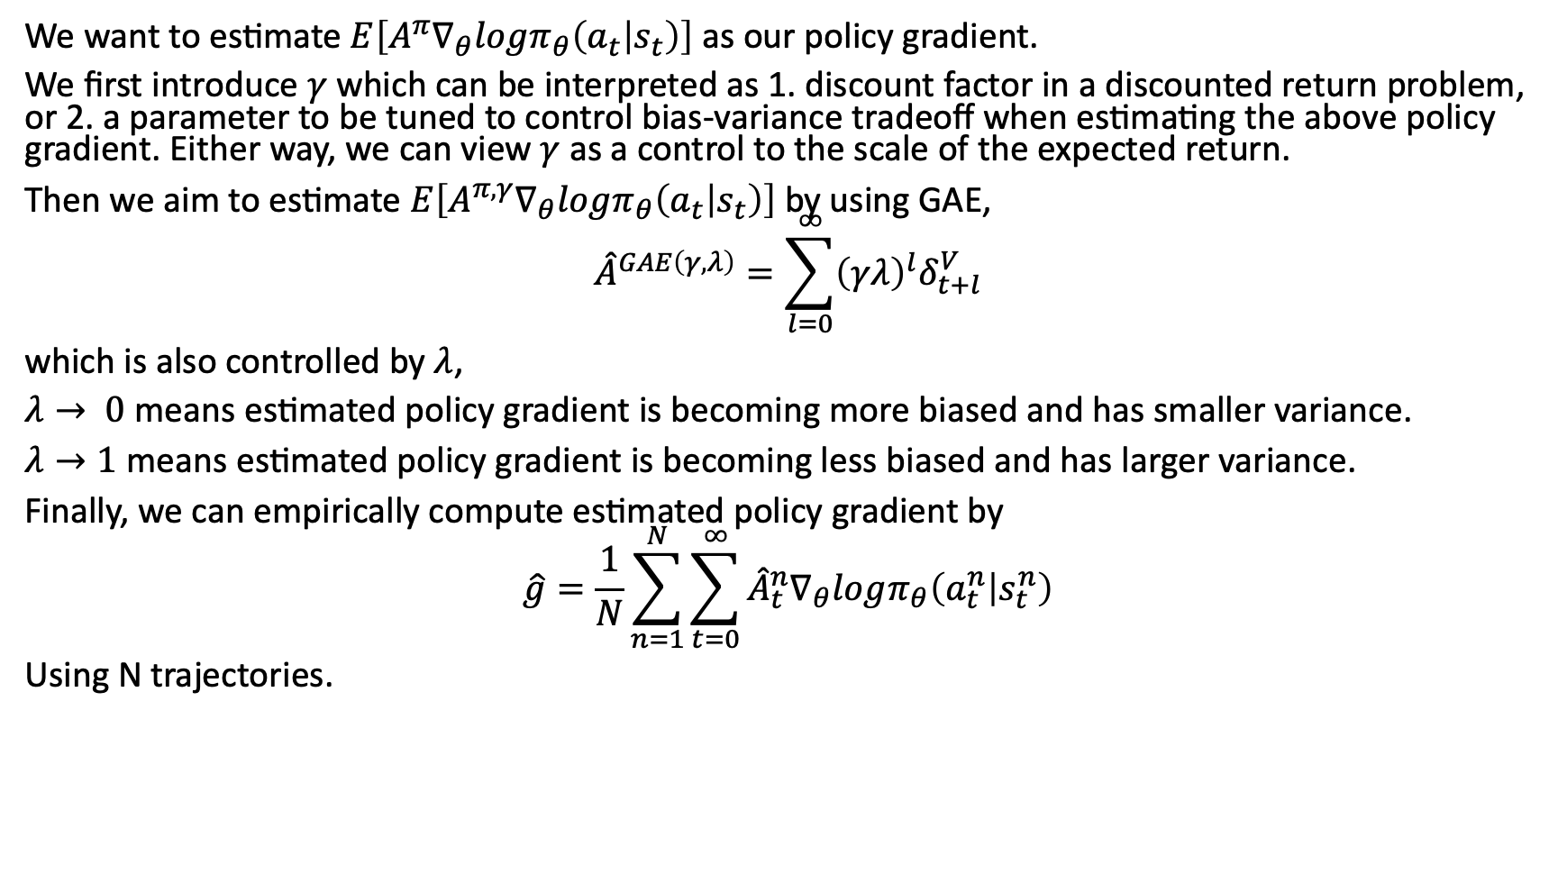
Summary
We want to estimate $E\left[A^{π}∇_{θ}logπ_{θ}\left(a_{t} | s_{t}\right)\right]$ as our policy gradient.
We first introduce $γ$ which can be interpreted as 1. discount factor in a discounted return problem, or 2. a parameter to be tuned to control bias-variance tradeoff when estimating the above policy gradient. Either way, we can view $γ$ as a control to the scale of the expected return.
Then we aim to estimate $E\left[A^{π,γ}∇_{θ}logπ_{θ}\left(a_{t} | s_{t}\right)\right]$ by using GAE,
$${\hat{A}}^{GAE\left(γ,λ\right)}=\sum_{l=0}^{∞}{{\left(γλ\right)}^{l}δ_{t+l}^{V}}$$
which is also controlled by $λ$,
$λ→ 0$ means estimated policy gradient is becoming more biased and has smaller variance.
$λ→1$ means estimated policy gradient is becoming less biased and has larger variance.
Finally, we can empirically compute estimated policy gradient by
$$\hat{g}=\frac{1}{N}\sum_{n=1}^{N}{\sum_{t=0}^{∞}{{\hat{A}}_{t}^{n}∇_{θ}logπ_{θ}\left(a_{t}^{n} | s_{t}^{n}\right)}}$$
Using N trajectories.

Slide 14
Schulman, John & Moritz, Philipp & Levine, Sergey & Jordan, Michael & Abbeel, Pieter. (2015).
High-Dimensional Continuous Control Using Generalized Advantage Estimation.

